Slide 1
Relational Model (Part-2 of 2)

Slide 2
Example of Relations
Banking Example
branch (branch_name, branch_city, assets)
customer (customer_name, customer_street, customer_city)
account (account_number, branch_name, balance)
loan (loan_number, branch_name, amount)
depositor (customer_name, account_number)
borrower (customer_name, loan_number)

Slide 3
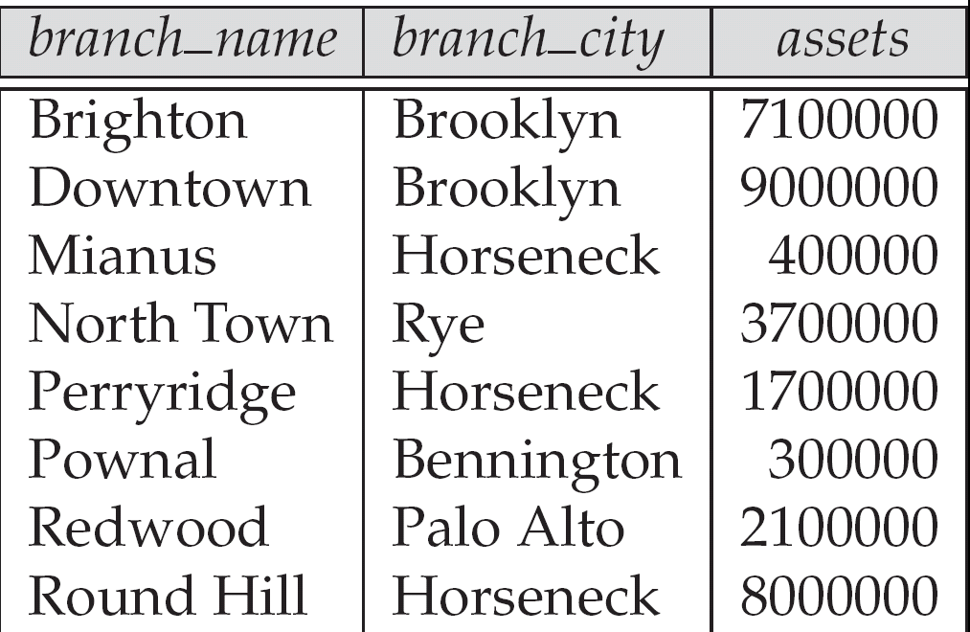
1. The branch relation

Slide 4

2. customer Relation

Slide 5

3. Account Relation

Slide 6

4. The loan relation

Slide 7

5. The depositor Relation

Slide 8
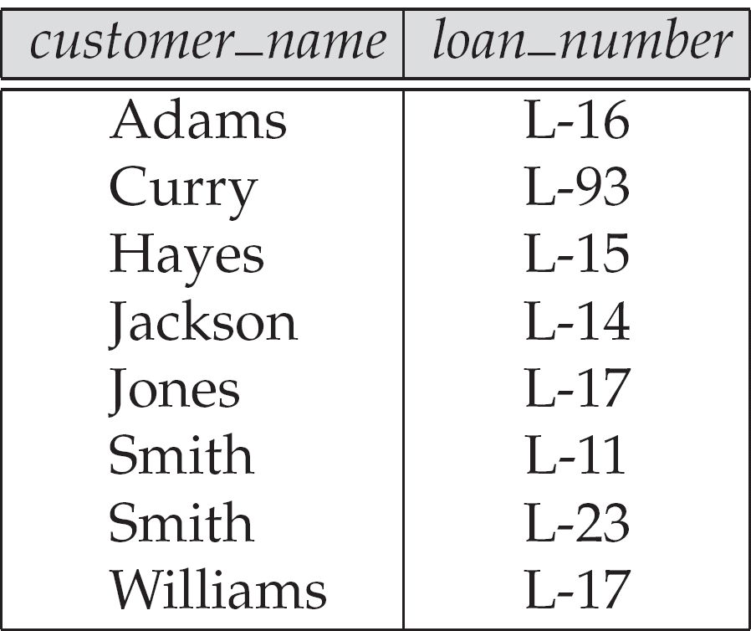
6. The borrower relation

Slide 9
Example Queries
branch (branch_name, branch_city, assets)
customer (customer_name, customer_street, customer_city)
account (account_number, branch_name, balance)
loan (loan_number, branch_name, amount)
depositor (customer_name, account_number)
borrower (customer_name, loan_number)
Find all loans of over $1200
Find the loan number for each loan of an amount greater than $1200
Find the names of all customers who have a loan, an account, or both, from the bank

Slide 10
Answers: Example Queries
Find all loans of over $1200
σ_{amount > 1200} (loan)
Find the loan number for each loan of an amount greater than $1200
∏_{loan_number} (σ_{amount} _{> 1200} (loan))
Find the names of all customers who have a loan, an account, or both, from the bank
  ∏_{customer_name} (borrower) ∪ ∏_{customer_name} (depositor)

Slide 11
Example Queries
branch (branch_name, branch_city, assets)
customer (customer_name, customer_street, customer_city)
account (account_number, branch_name, balance)
loan (loan_number, branch_name, amount)
depositor (customer_name, account_number)
borrower (customer_name, loan_number)
Find the names of all customers who have a loan at the Perryridge branch.
Find the names of all customers who have a loan at the
Perryridge branch but do not have an account at any branch of the bank.

Slide 12
Answers: Example Queries
Find the names of all customers who have a loan at the Perryridge branch.
∏_{customer_name} (σ_{branch_name=“Perryridge”}
(σborrower.loan_number = loan.loan_number(borrower x loan)))
Find the names of all customers who have a loan at the
Perryridge branch but do not have an account at any branch of
the bank.
∏_{customer_name} (σ_{branch_name = “Perryridge”}
(σborrower.loan_number = loan.loan_number(borrower x loan))) –
∏_{customer_name}(depositor)

Slide 13
Alternate Method
Find the names of all customers who have a loan at the Perryridge branch.
  Query 1
  ∏_{customer_name} (σ_{branch_name = “Perryridge”} (
  σborrower.loan_number = loan.loan_number (borrower x loan)))
  Query 2
  ∏_{customer_name}(σloan.loan_number = borrower.loan_number (
  (σ_{branch_name = “Perryridge”} (loan)) x borrower))

Slide 14
Reference
System Concepts
Abraham Silberschatz, Henry F. Korth, S. Sudarshan
Tata McGraw-Hill

